Slide 1


Hass Avocado Dashboard
Harrison Lucas

Slide 2

Purpose
To allow users to visualize data of our avocado sales.

Slide 3

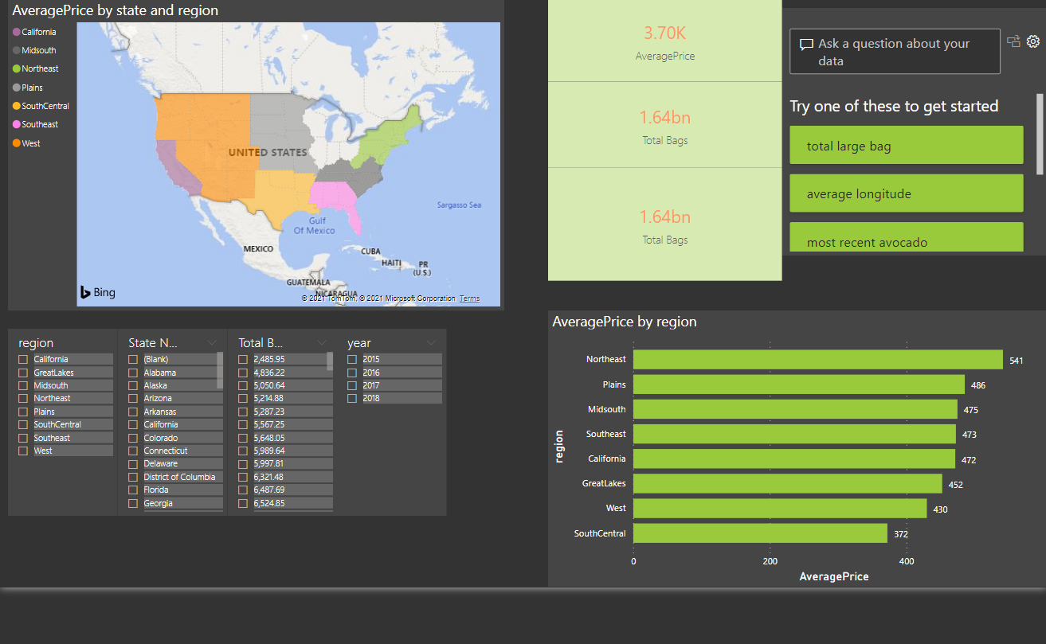
What I built
I built an interactive dashboard allowing users to view maps and graphs based on data from the avocado board.
Slicers and cards make it easy to filter data and see data points based on those filters.
Users can ask questions in the dashboard.

Slide 4
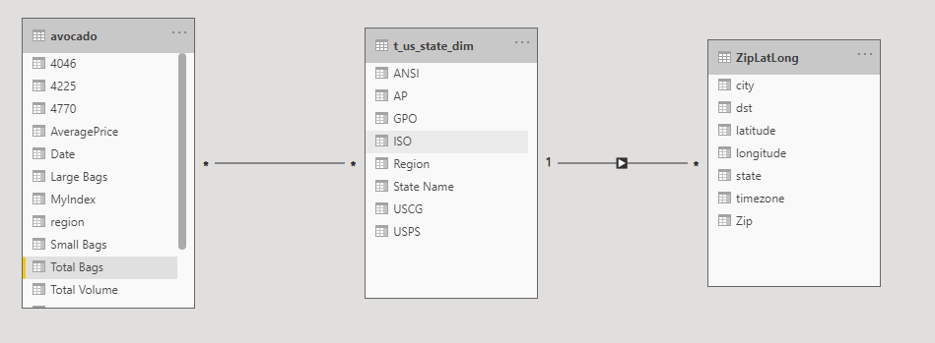
What I built
I built an interactive dashboard allowing users to view maps and graphs based on data from the avocado board.
Slicers and cards make it easy to filter data and see data points based on those filters.
Users can ask questions in the dashboard.

Slide 5
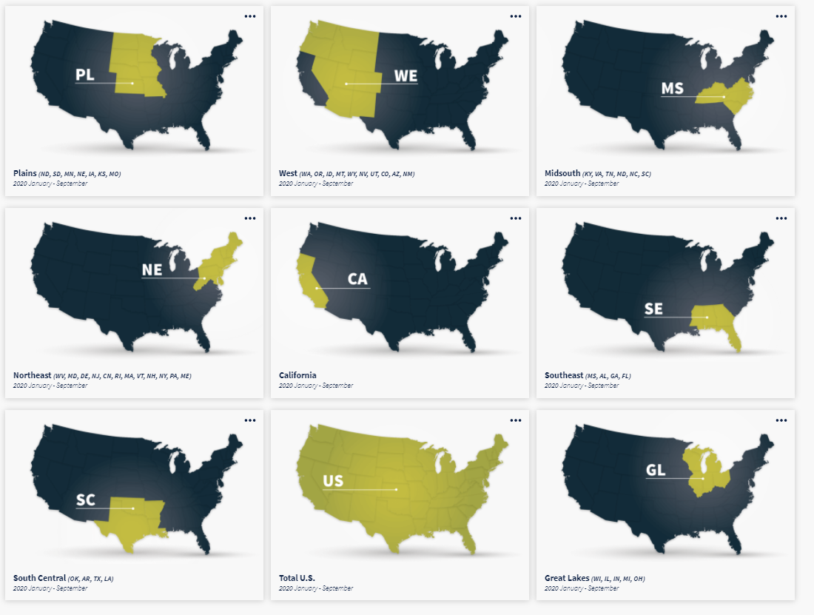
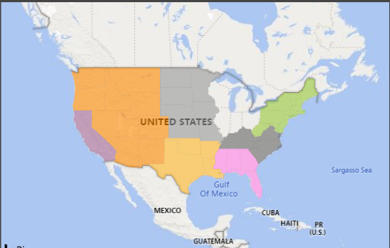
Larger Geo area groups
These area groups are what I used based on the website's regional division, which had 8 regions.

Slide 6
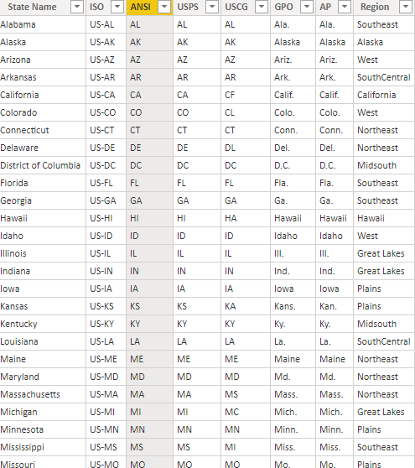
Region Data
I assigned the region value as described on the hass avocado website to each state.
I elected to ignore data outside of those 8 regions.

Slide 7
Larger Metro area groups
I ignored data in those groups. I interpreted it as unnecessary based on the regions that the website had already defined had data points.

